Slide 1
Online Hotel Reservation

Slide 2
CSE411 Software Engineering & Information System Design
Instructor: Dr. Mohammad Salah Uddin
Assistant Professor
Department of CSE
East West University
Group Members: Md Fahimul Islam (2017-1-62-022)
Md. Jusef (2017-2-60-160)
Wasiur Rahman (2017-1-60-115)

Slide 3
Introduction
Online Hotel Reservation system will provide service to online customers, and an administration. Online customer can make searches reservation and cancel an existing reservation on the hotel reservation’s website. Administrator can add/update the hotel and room information.
The project, Online Hotel Reservation System is a web-based application that allows the hotel manager to handle all hotel activities online. Interactive GUI and the ability to manage various hotel bookings and rooms make this system very flexible and convenient. The hotel manager is a very busy person and does not have the time to sit and manage the entire activities manually on paper. This application gives him the power and flexibility to manage the entire system from a single online system. “Online hotel reservation” project provides room booking system. The system allows the manager to post available rooms in the system. Customers can view and book room online. Admin has the power of either approving or disapproving the customer’s booking request. Other hotel services can also be viewed by the customers and can book them too. The system is hence useful for both customers and managers to portable manage the hotel activities.

Slide 4
Motivations
Cox’s International Travel is an tourist agent which provides the facilities for booking hotels, houses, holiday apartments and other accommodations for customers. Any customers need to book hotel or apartment. they need to visit their office which is situated in Kolatoli for checking the availability as well as negotiation. Recently they have decided to change their booking pattern from manual to web based system. It will help them to manage the customers booking easily and also to keep the customers data safer. It will also help staffs to keep in track their customer’s online booking request as well as easily to reply feedback to the customers. This is my motivation for work in this project. customer can easily book their choice able hotels or apartment. Saves time of customers for quickly reserving room.

Slide 5
Functional Requirements
1.Registration:
The user must register into the system by entering name, contact information, Email Address. The email address and the contact information must be valid for authentication purpose. For invalid email address the system should not allow the user to register and will show an error message.
2. Login:
For login the user needs to input user id and password, then the system will check if both the inputs are correct or not if both are correct then a new page will open for the user with options available for further actions. In the case of invalid user id or password the system will show an error and the user must give the user id and password again.

Slide 6
Functional Requirements
3. Booking/Reservation:
The user must reserve a room at least three days before their arrival in the hotel. User need to give all the information about the place where he/she wants to book a room. Then the user can choose the preferable hotel from there. The user also needs to give the information about how many days he/she wants to reserve/book the room.
4. Make Payment:
The payment system should be user friendly. The system should accept payment from both card and Bkash. After successful payment the system should show a message for confirming the user.

Slide 7
Functional Requirements
5. Cancel Reservation:
The user can cancel the reservation within two days of booking and then they will be refunded. If the user failed to cancel the reservation within two days, then there will not be refunded. In the same process the authority can also cancel the reservation, in that case the user will be refunded.
6. Admin Login:
The admin can login to the system by using the user id and password which are assigned to them. They can update the system and also can make any necessary changes in the system. All the actions should be recorded into the database of the system.

Slide 8
Non-functional Requirements
1. Performance Requirements:
The system should be functional for 24 hours a day to enable user interaction at any point of time.
2. Safety Requirements:
The database should be carefully maintained by the administrator any loss may harm the entire system.
3. Security Requirements:
The information of the user and the admins should be secured enough. The user id and password also needed to be encrypted. The database and the account information also needed to be secured properly. Any leakage of information can hamper the whole system.
4. Software Quality Attributes:
Adaptability: The system should be able to adapted with the new changes.
Availability: The system should be able to give services 24/7.
Interoperability: Each interface makes the use of information provided by other.
Flexibility: The system should provide highly flexible services to the users.
Portability: The system should run in every operating system such as Microsoft Windows, Ubuntu.
Maintainability: The project is going to be developed using php and MySQL so the system should be easy to maintain.

Slide 9
Feasibility Studies
Technical feasibility:
The hotel booking case aims to bring a better experience for users who are busy with professional work and do not know the location and other information. Hotel managers can frequently update the database and publish available rooms in the system. This application is developed using HTML, PHP, CSS and MYSQL and more within given time.
Operational feasibility:
Our system is here to help people find better rooms easily. We prepare facilities for booking hotels to our customers. Customers can easily book the room they want. The owner can confirm the reservation and offer the room within the delivery time. Customers can pay after booking online. This system is very useful for those who need a room or apartment in many cases.
Economic Feasibility:
This project is not profitable, because we no longer consider making money from it, so there is no economic feasibility.

Slide 10
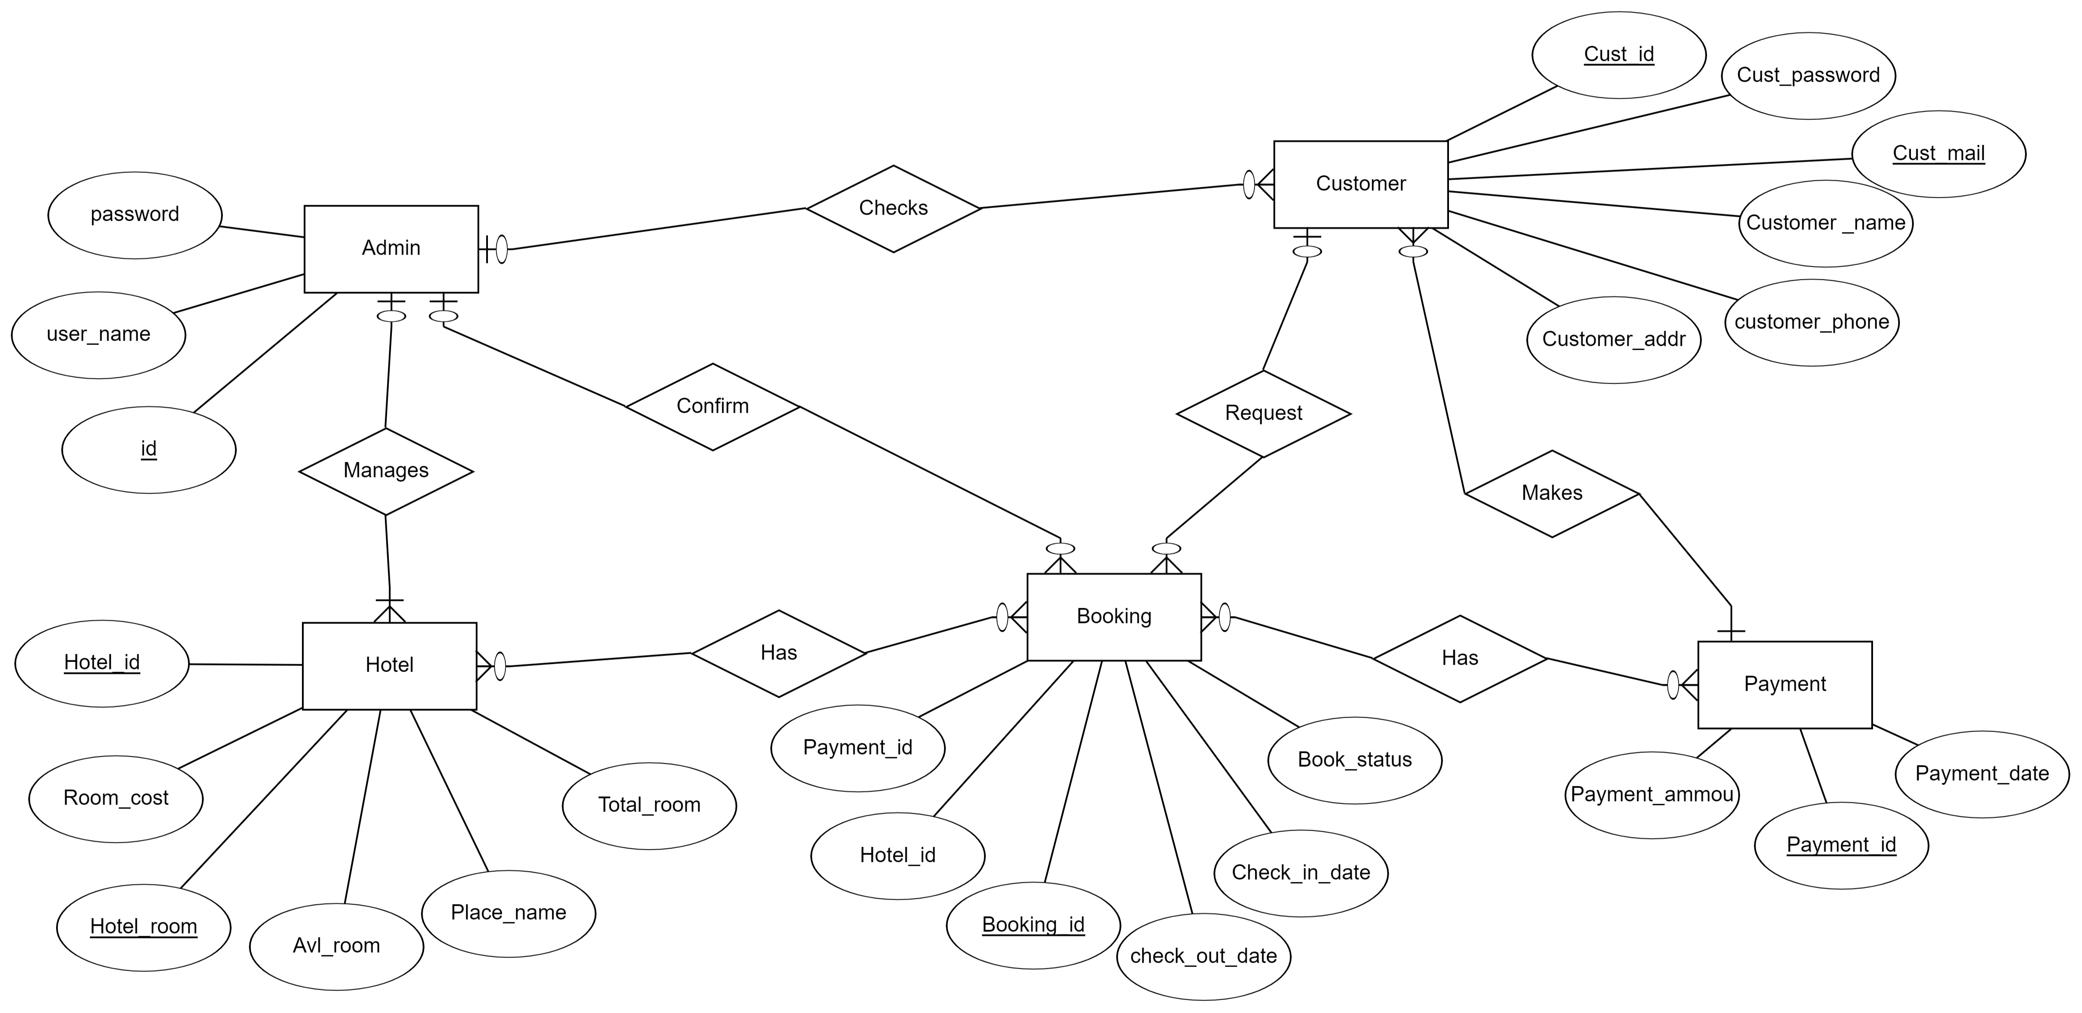
ER Diagram

Slide 11
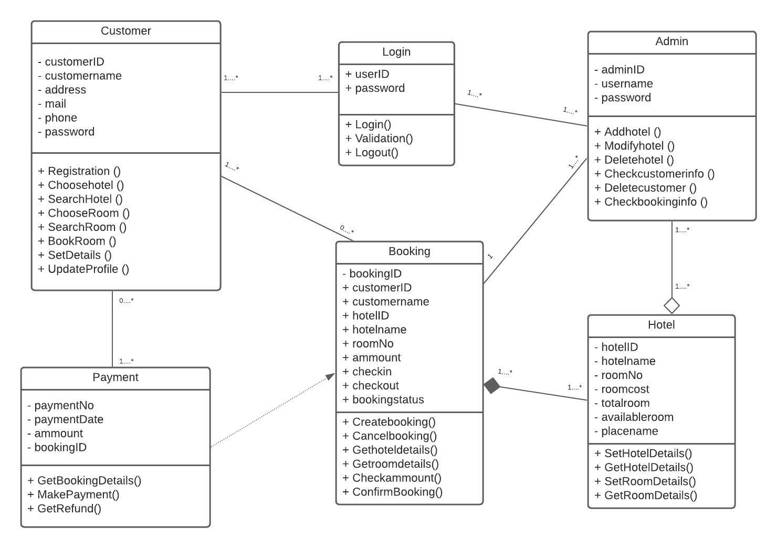
Class Diagram

Slide 12
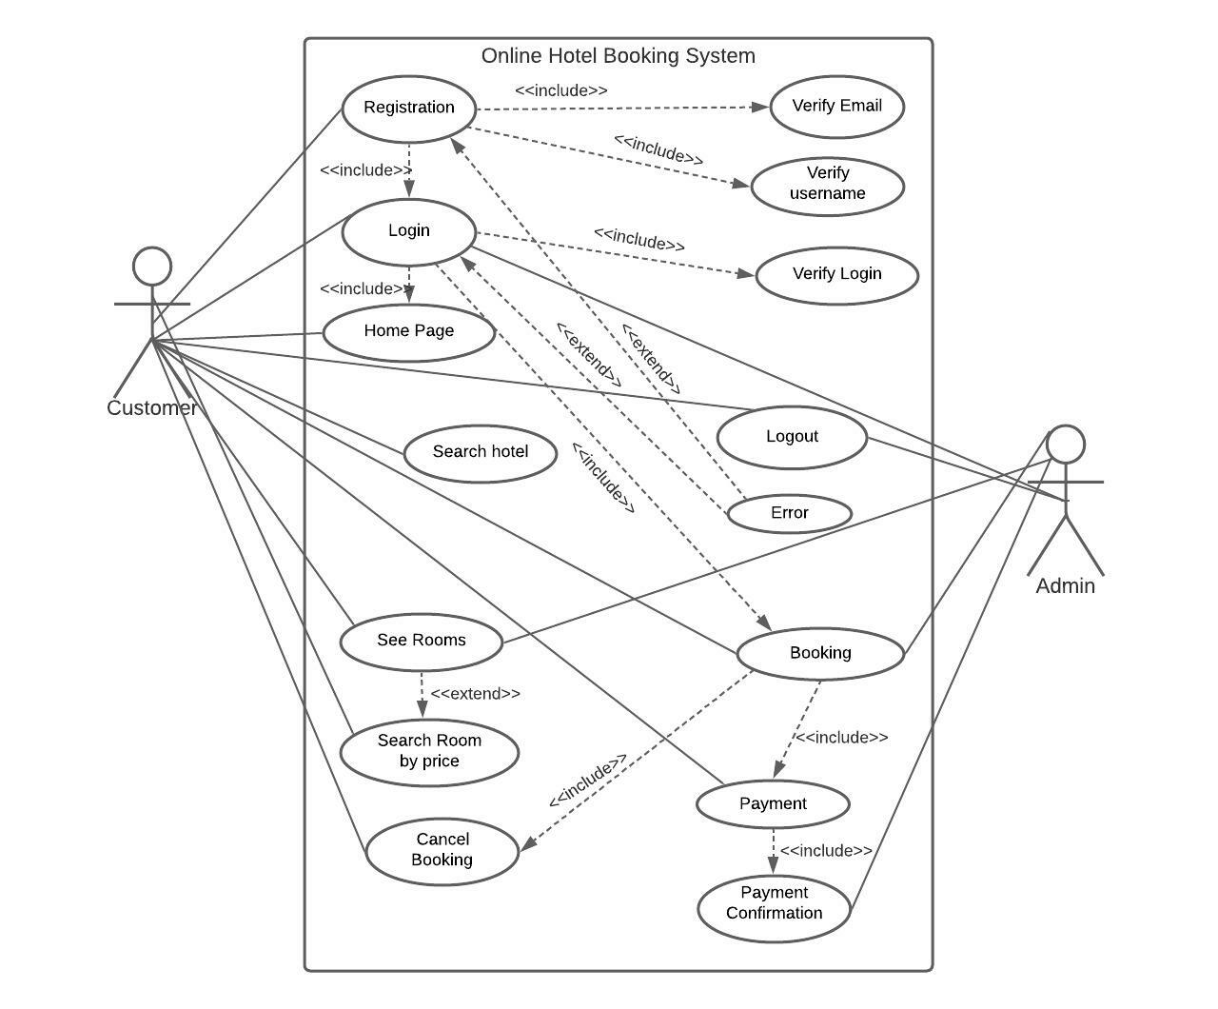
Use Case Diagram

Slide 13
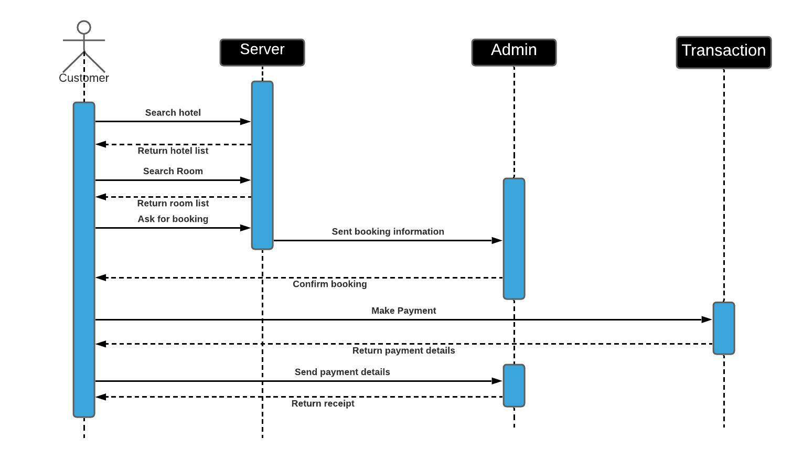
Sequence Diagram

Slide 14
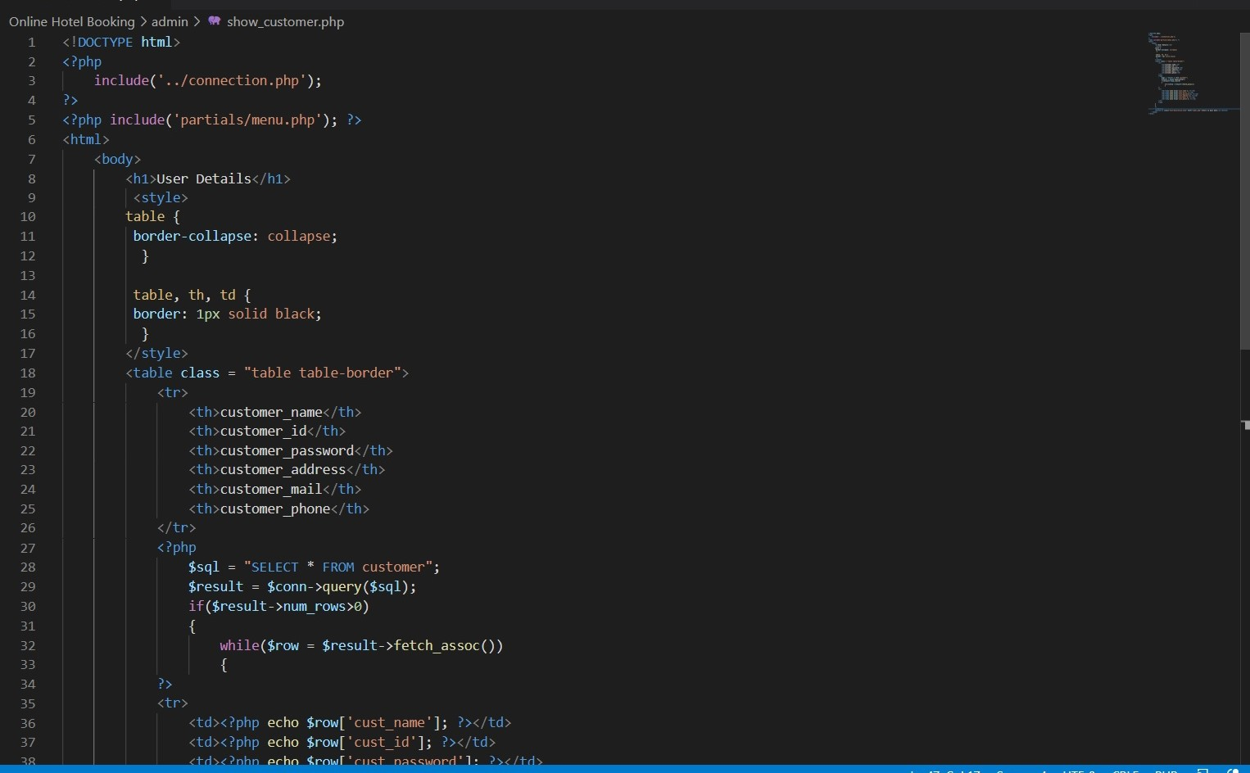
Test Code To Show Customer

Slide 15
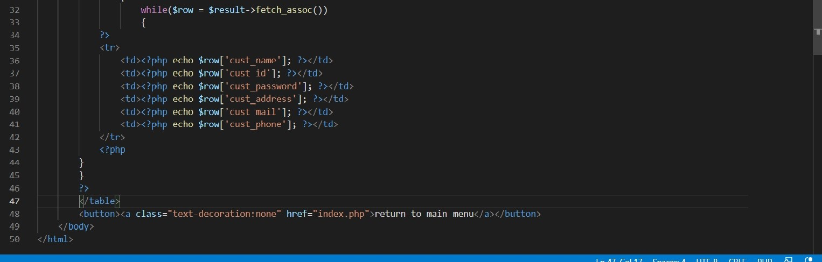
Test Code To Show Customer

Slide 16
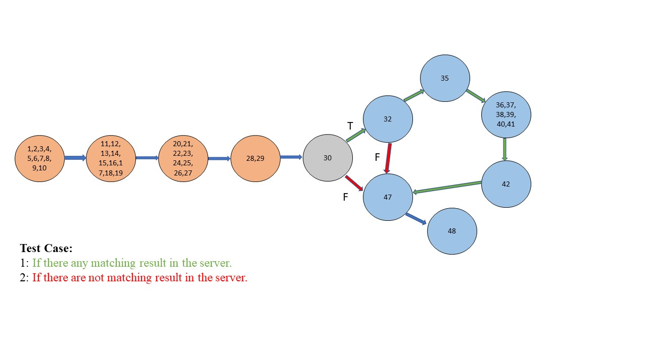
White Box Testing Solution To Show Customer

Slide 17
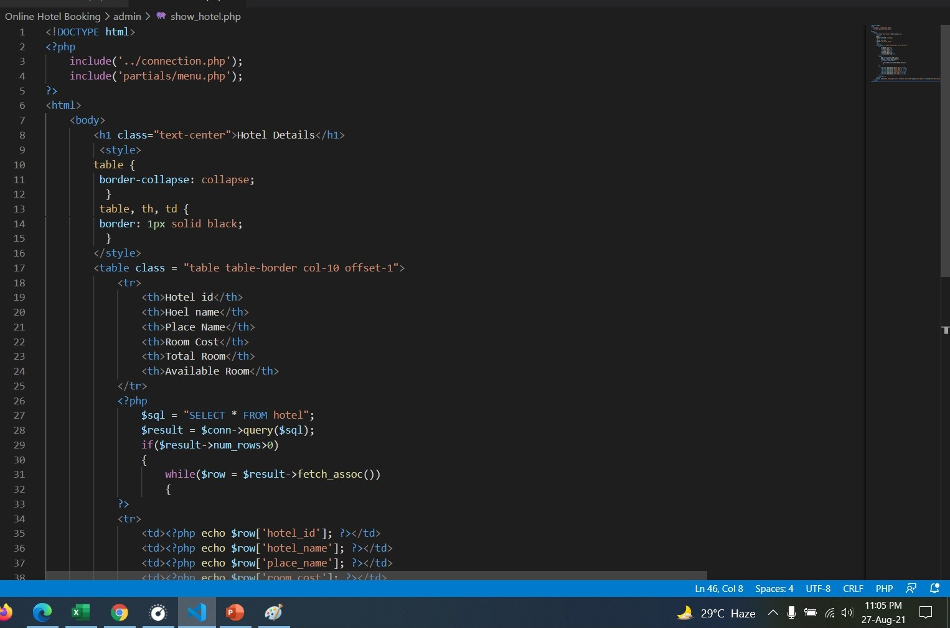
Test Code To Show Hotel

Slide 18
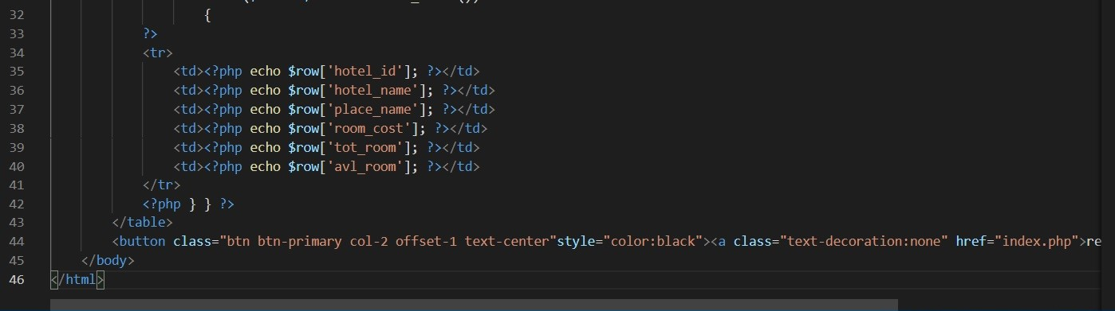
Test Code To Show Hotel

Slide 19
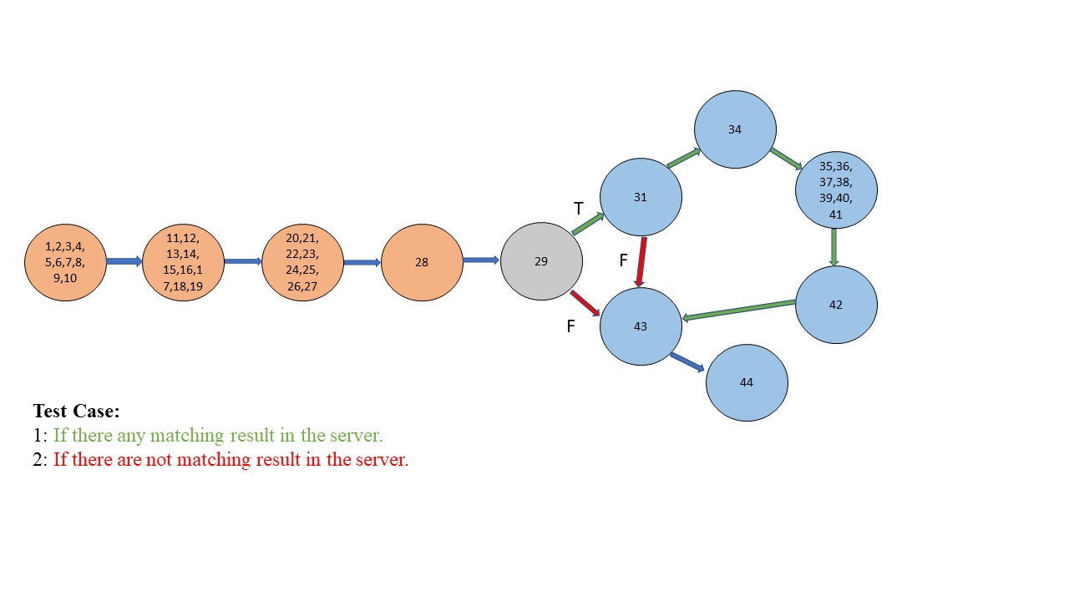
White Box Testing Solution To Show Hotel

Slide 20
Future Work
Suitable Details Room suggestion.
Interactive User Interface.
Developing an App.
Integrating more features.
High level Security provide.

Slide 21
Thank You!

